Slide 1
DAILY OZONER ANALYSIS

Slide 2
INTRODUCTION
ABOUT THE DATA
The data comes from EPA’s Air Quality System (AQS). All the collected reports are aggregated and summarized by the EPA system. All the data were compressed into a single Comma-Separated Value.
the data includes the pollution standards and the air quality standards.
the numbers in the dataset we have were calculated are An 8-hour average that is calculated for every clock hour
The dataset Included 52 States, 517 counties, and 674 cities in the USA. The data were calculated from 2020 to 2021.

Slide 3
Select the Variables for Visualization:
1st Max Value AQI
Arithmetic mean latitude longitude
State Name Observation Count Event type
Variables
& Hierarchy
Hierarchy :
Location State Name
County Name City Name

Slide 4

Questions
Q1 | WHICH STATE HAD THE HIGHEST ' 1ST MAX VAULE' ?
Q2 | ANALYZE THE AVERAGE AQI BASED ON STATE NAME
Q3 | ANALYZE THE OBSERVATION COUNT AND ARTHEMETIC MEAN BY STATE NAME
Q4 | ANALYZE THE EFFECT OF EVENT TYPE ON AQI?

Slide 5
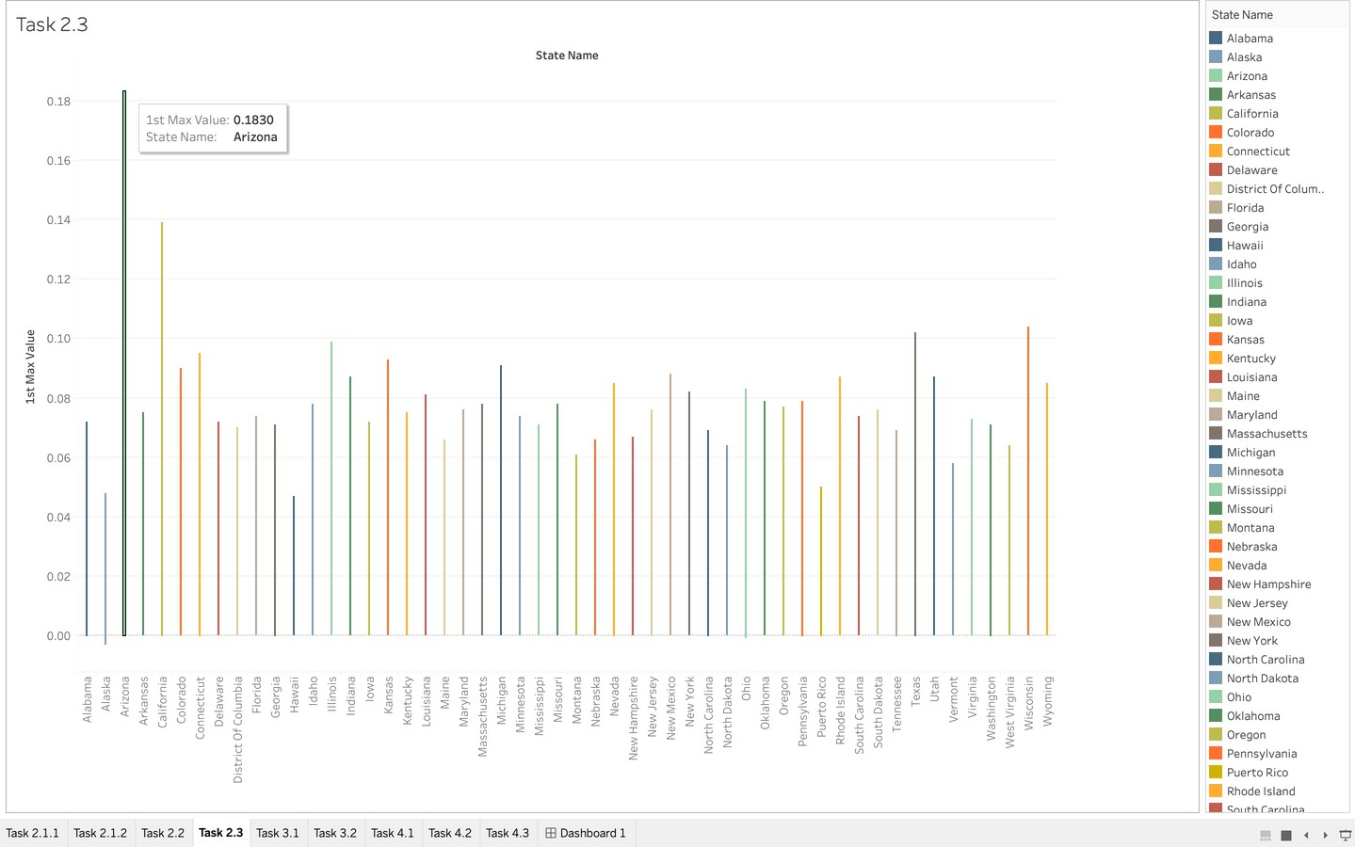
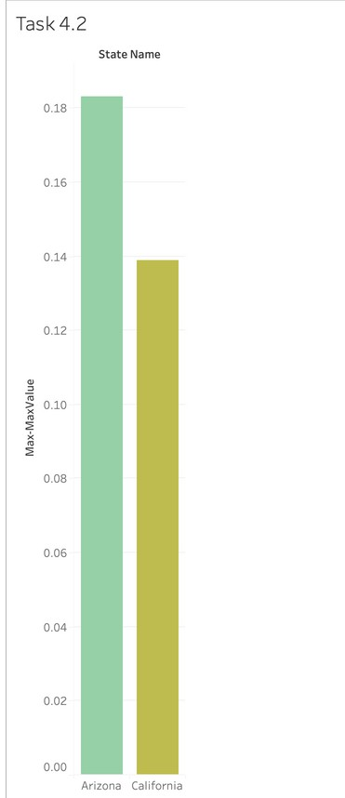
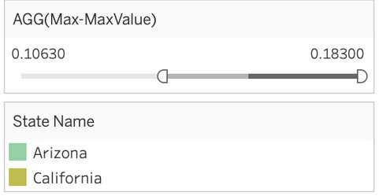
Q1 | WHICH STATE HAD THE HIGHEST ' 1ST MAX VAULE' ?
TWO VARABLES OF TWO DIFFERENT TYPES - BAR GRAPH (1) CACLCUALTION FIELD & FILTER - BAR GRAPH (2)
The question here is about the first max value of particle pollution that the measurement instrument caught . As shown above, Arizona and California has the average of max-value of pollution. That might be Due some geographical features and area of the state.

Slide 6
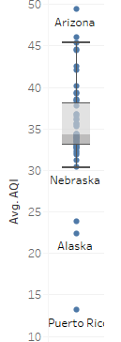
Q2 | ANALYZE THE AVERAGE AQI BASED ON STATE NAME
SINGLE VARIABLE ( CONTINOUS) - BOXPLOT
At first, we tried to only represent the AQI as a single variable and used the state name as a label but as it is shown in the graph. it seems like Arizona and Alaska are outliers here, their values have passed the max and min lines so the box plot might not be the best way to analyze it.

Slide 7
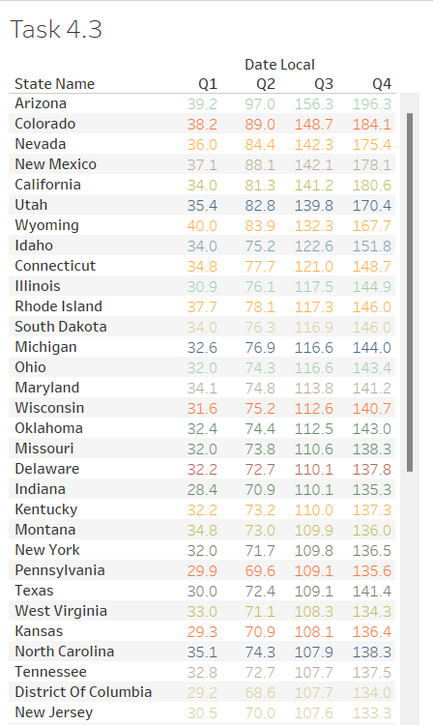
Q2 | ANALYZE THE AVERAGE AQI BASED ON STATE NAME
TABLE CALCULATION
the table is showing the average AQI for the four quarters. In general, the fourth quarter has the highest numbers of all the quarters. But it is easier to analyze after sorting the results descending or ascending.
the first three states that have the highest average overall in the four quarters, are Arizona, Colorado, and Nevada.

Slide 8
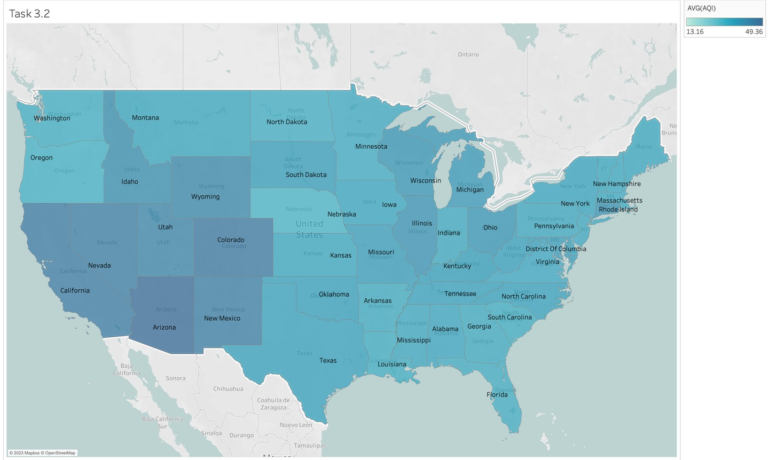
Q2 | ANALYZE THE AVERAGE AQI BASED ON STATE NAME
GEOSPATIAL MAP
We can see that Arizona has the darkest shade which means the highest (AQI). and the higher the number the more polluted the air quality can be.
but it became harder to differentiate the other states due to the color similarity.
the AQI can be seen to associated with the area of the state too.

Slide 9
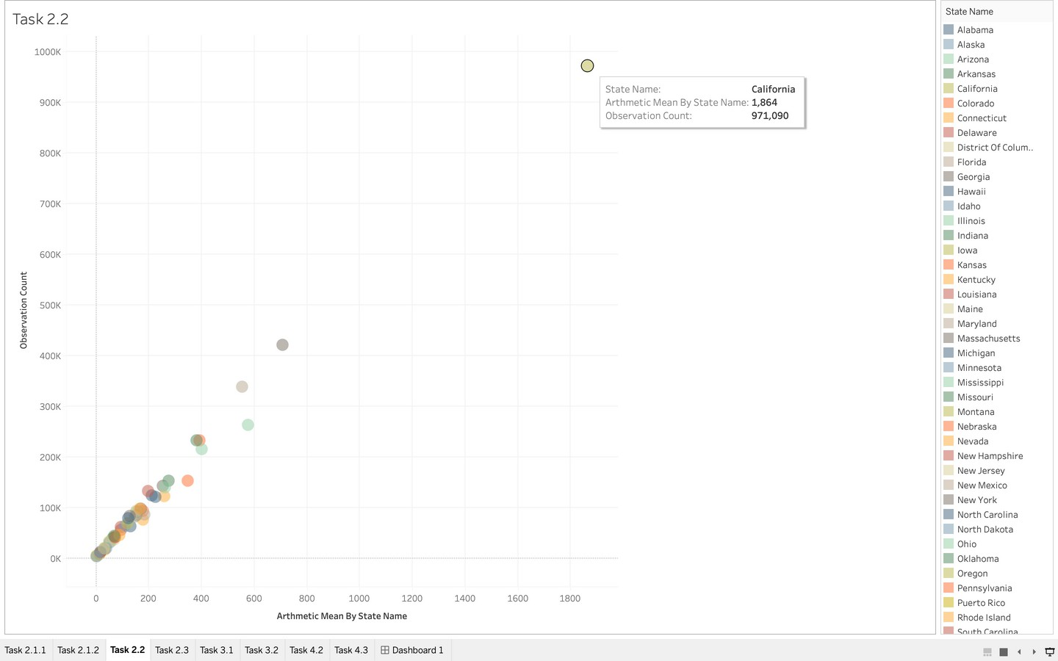
Q3 | ANALYZE THE OBSERVATION COUNT AND ARTHEMETIC MEAN BY STATE NAME
TWO CONTINOUS VARIABLES - SCATTER PLOT & LOD EXPRESSION
This scatter plot here is visualizing how the arithmetic mean is correlated with number of observations.
We can see that most of the
records are strong positively correlated.
the arithmetic mean is the
aggregation of results of the standards.

Slide 10
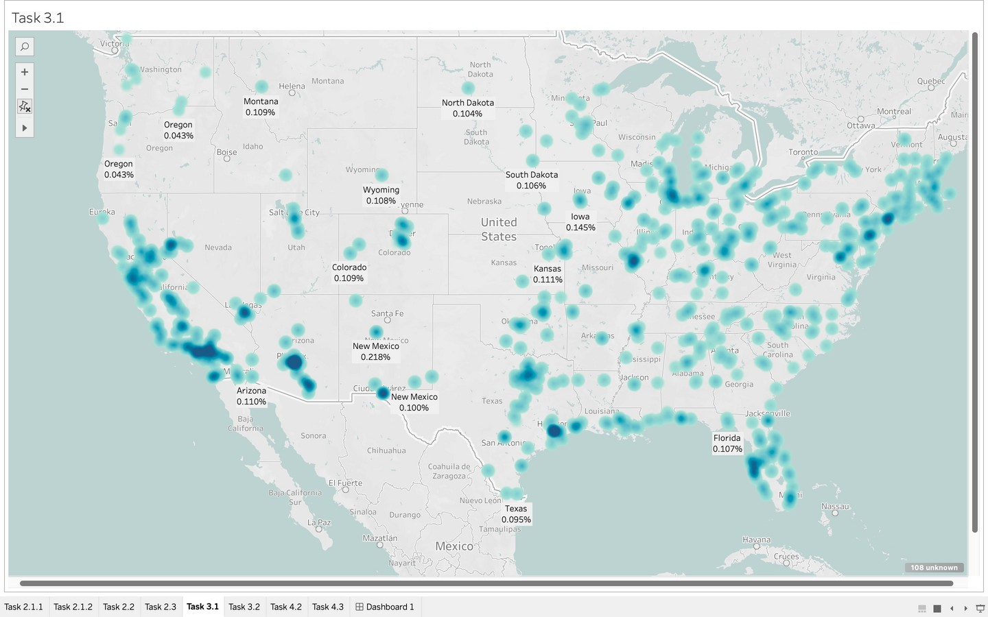
Q3 | ANALYZE THE OBSERVATION COUNT AND ARTHEMETIC MEAN BY STATE NAME
GEOSPATIAL MAP
In the geospatial map. We can see the distribution of the observations over the 52 states.
The percentage of observations count are shown as text and average arithmetic is visualized as color brightness. The darker the shade is the higher the arithmetic mean.
even though Arizona had less number of observations but still got a high arithmetic mean

Slide 11
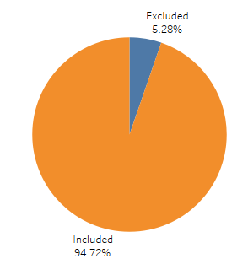
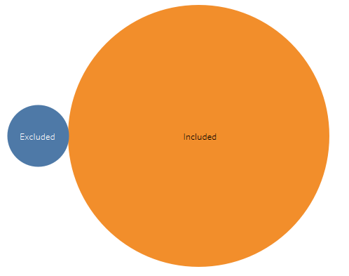
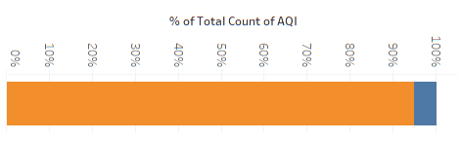
These visualizations show us the effect of the occurrence of an event on the AQI ratio, we clearly note the impact of the occurrence of events on air pollution
Q4 | ANALYZE THE EFFECT OF EVENT TYPE ON AQI?
The representation was done in three different ways to convey the meaning
bubbles Pie
Fixed bars
In this case, we choose bubbles because it communicates meaning and feeling more, especially its association with air, which will make it the most appropriate choice

Slide 12
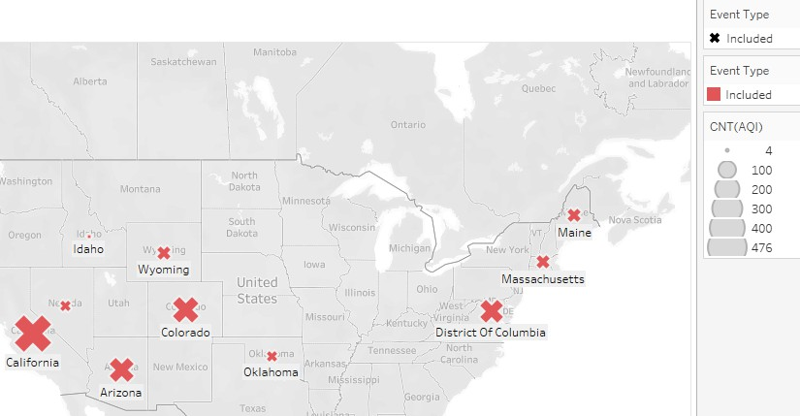
Q4 | ANALYZE THE EFFECT OF EVENT TYPE ON AQI?
This visualization was used to display the aql difference in the locations where the events occurred during the month (June and August).
Size has been used to represent it correctly

Slide 13
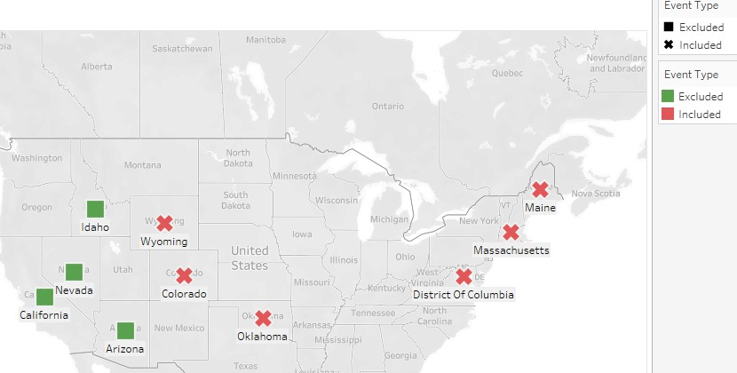
Q4 | ANALYZE THE EFFECT OF EVENT TYPE ON AQI?
actually, this specifically answers the question: What are the places where events occurred during the months (of June and August)?
Colors and shapes are used for representation in this map

Slide 14
CONCLUSION
After we visualized the data from different angles, we found that Arizona and California have the most 1st max vaule
We also represented AQI on a map and how it varies across states, along with what factors are likely to cause it.
We also showed a linear relationship between the mean and the number of observations taken, which may be because taking a lot of observations may be one of the reasons why the mean values are observed more.
On the other hand, we discussed the relationship of occurrence of events with pollution and how it caused an increase in air pollution, specifically the areas prone to events in specific months.

Slide 15
THANK YOU FOR LISTENIG

